Slide 1
Opening
MAE301 Applied Experimental Statistics
“Max” Yi Ren
ASU Spring 2026

Slide 2

Course overview
Objective: Learning the necessary fundamentals to understand generative AI:
* Random variable, probability distributions, Bayes’ theorem, Central limit theorem
- A formal language to describe random events, e.g., “what is the chance of raining tomorrow?”

Slide 3
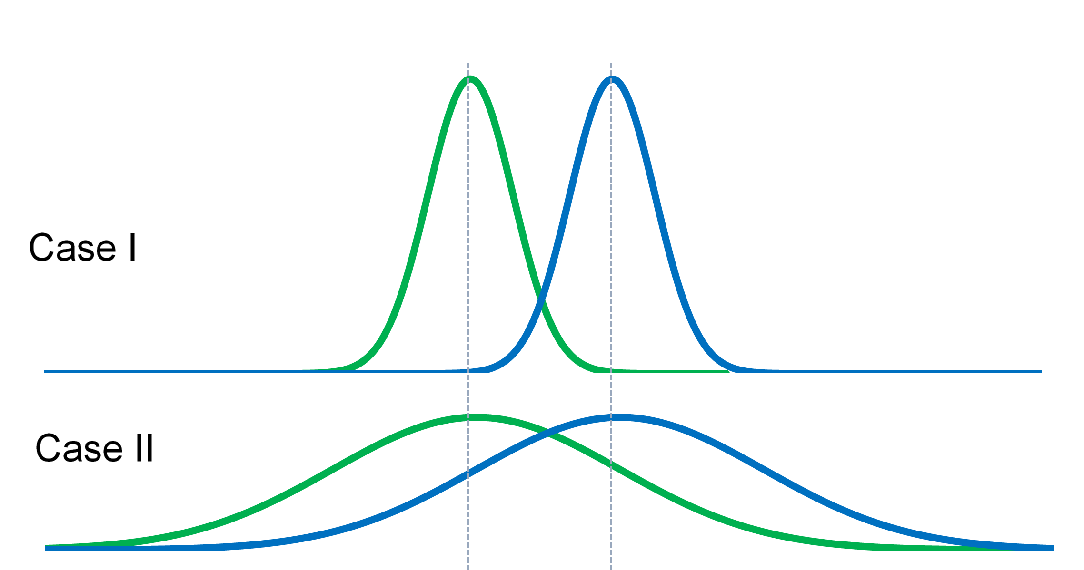
Course overview
Objective: Learning the necessary fundamentals to understand generative AI:
* Random variable, probability distributions, Bayes’ theorem, Central limit theorem
* Hypothesis test, confidence interval
- Make conclusions based on data and under uncertainty, e.g., “Is this year’s precipitation abnormal?”

Slide 4
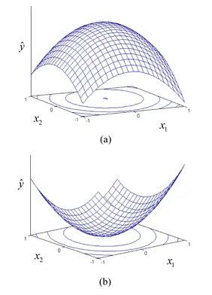
Course overview
Objective: Learning the necessary fundamentals to understand generative AI:
* Random variable, probability distributions, Bayes’ theorem, Central limit theorem
* Hypothesis test, confidence interval
* Linear algebra, matrix calculus, optimization theory
Principles for decision making, e.g., “what would be the best model to predict next-day precipitation rate based on the data and knowledge we have?”

Slide 5
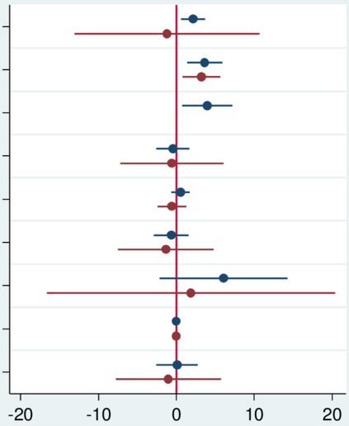
Course overview
Objective: Learning the necessary fundamentals to understand generative AI:
* Random variable, probability distributions, Bayes’ theorem, Central limit theorem
* Hypothesis test, confidence interval
* Linear algebra, matrix calculus, optimization theory
* Regression, design of experiment, ANOVA
- Classic methods for explaining data, e.g., “according to the data, what are the key observables that affect the next-day precipitation rate?”

Slide 6
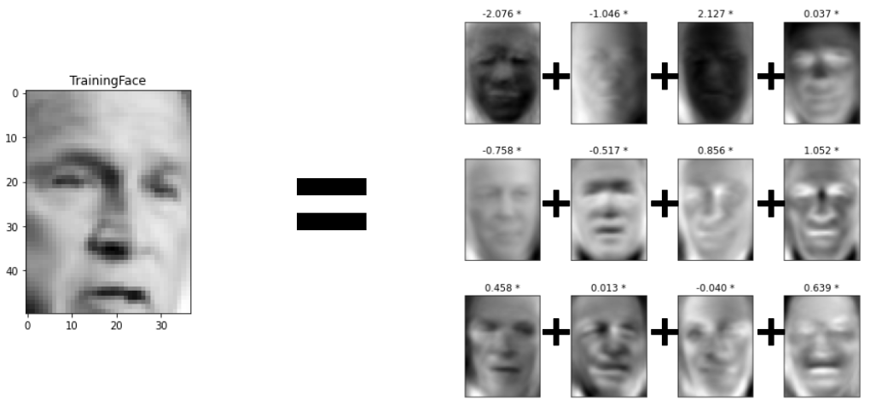
Course overview
Objective: Learning the necessary fundamentals to understand generative AI:
* Singular value decomposition, principal component analysis
- Classic methods for understanding intrinsic high-dimensional data structure, e.g., “What are the common spatial-temporal precipitation patterns in Arizona?”

Slide 7
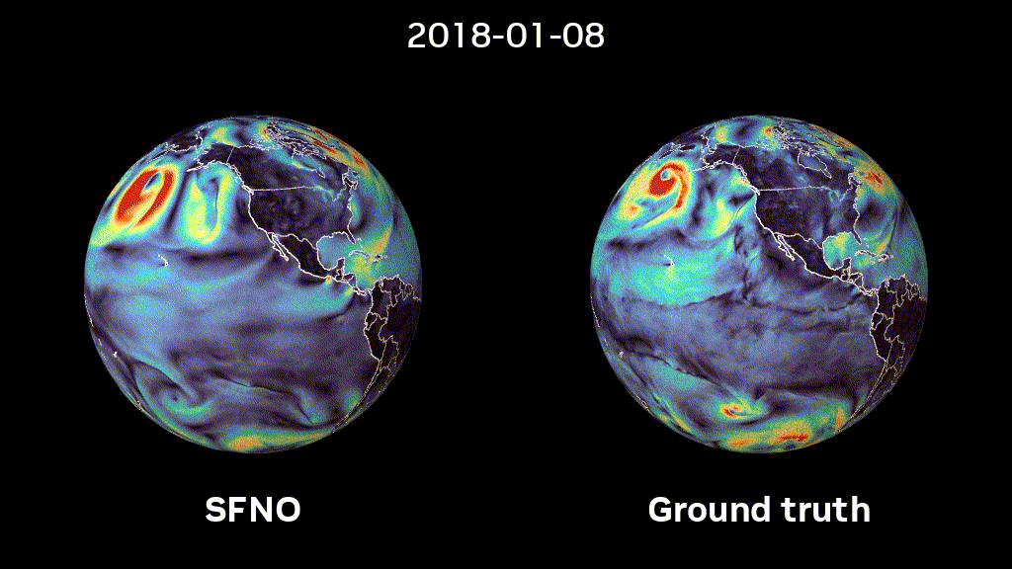
Course overview
Objective: Learning the necessary fundamentals to understand generative AI:
* Neural networks, attention, residual, language model
- A modeling framework that considers intrinsic data structure, e.g., “according to the data and the dynamic nature of weather, what are the key observables that affect the next-day precipitation rate?”

Slide 8
Course team project “why not?”
Objective: Gain experience at building generative models
Phase 1 (due Mar. 16): Propose an AI startup idea (report + short video). Presentation on Mar. 18 after in-class peer review.
Phase 2 (due Apr. 13): Submit a nano-GPT style language model (report + code).
Phase 3 (due Apr. 27): Submit a minimal viable product for your startup idea, using the language model as a baseline. Presentation on Apr. 29 and May. 01 after in-class peer review.
Teams will be randomly formed after class finalizes (before next Monday).

Slide 9
In-class activity: magic vs. magic
Objective: Strengthen your ability in self-learning with AI assistance
Phase 0: Topic keywords will be posted prior to the class for warm-up.
Phase 1: Team studies the presented problem for ~10 min. AI allowed.
Phase 2: A team is chosen randomly to give a chalk talk about the solution in 10 min. AI not allowed for presenters. Other teams can raise questions and volunteer to help if the first team cannot fully solve.

Slide 10
Grading
Exam 1 (Feb. 25): 15%
Exam 2 (Apr. 10): 15%
Project: 30%
Class participation: 40%

Slide 11
Preparation
You need to have/be familiar with:
AI assistance (GPT thinking/pro, Gemini pro, etc.)
Python & IDE (VS code, Cursor, etc.)
Git & Github (for managing team project)
Latex (for communicating math effectively with AI)
Do not learn from 101 style tutorial. Learn by doing and failing!

Slide 12
Required mindset for this class
Knowledge/experience no longer justifies your value.
Rethink why you spend time and money on education.
Get out of your comfort zone, think what actually makes you happy.
Embrace ignorance.

